Slide 1
LEARNING IS FUN- DAMENTAL: THE RIGHT TO EDUCATION FOR KIDS 6-14!

Slide 2
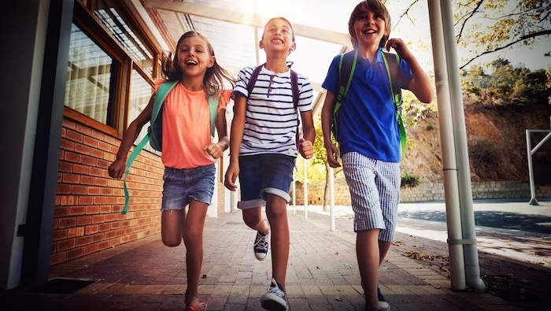
Welcome!
Learning is Fun-damental: The Right to Education for Kids 6-14! In this presentation, we will explore the importance of education for children and how it can positively impact their lives. Let's have some fun!

Slide 3

THE RIGHT TO EDUCATION
Education is a fundamental right for every child. It helps them develop critical thinking skills, gain knowledge, and prepare for their future.
Unfortunately, many children around the world still don't have access to education. Let's change that!

Slide 4
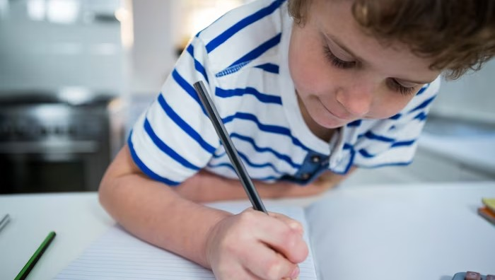
Beneﬁts of Education
Education has many beneﬁts for children, including improved cognitive development, better job opportunities, and increased social mobility. It also helps children develop important life skills, such as problem-solving and communication.

Slide 5
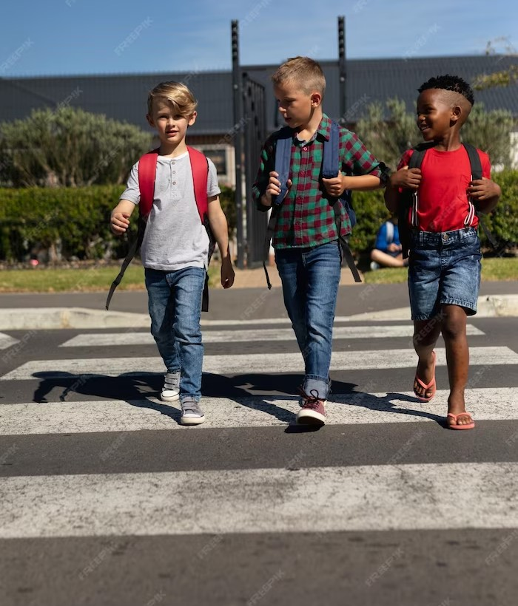
CHALLENGES TO EDUCATION
Despite the beneﬁts of education, there are many challenges that prevent children from accessing it. These include poverty, lack of resources, and discrimination. We need to work together to overcome these challenges and ensure that every child has the opportunity to learn.

Slide 6
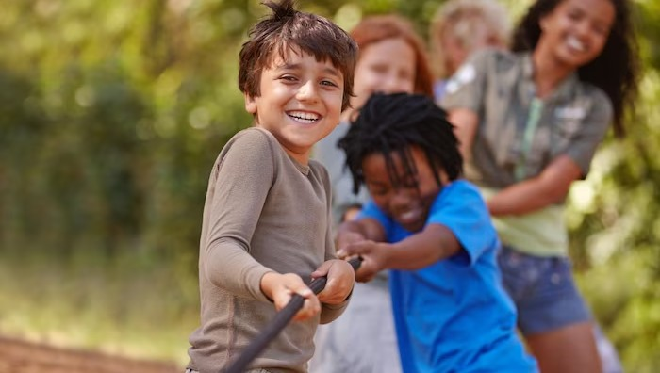
The Importance of Play
Play is an essential part of learning for children. It helps them develop creativity, social skills, and emotional intelligence. When children are engaged in play, they are more likely to be motivated and interested in learning.

Slide 7
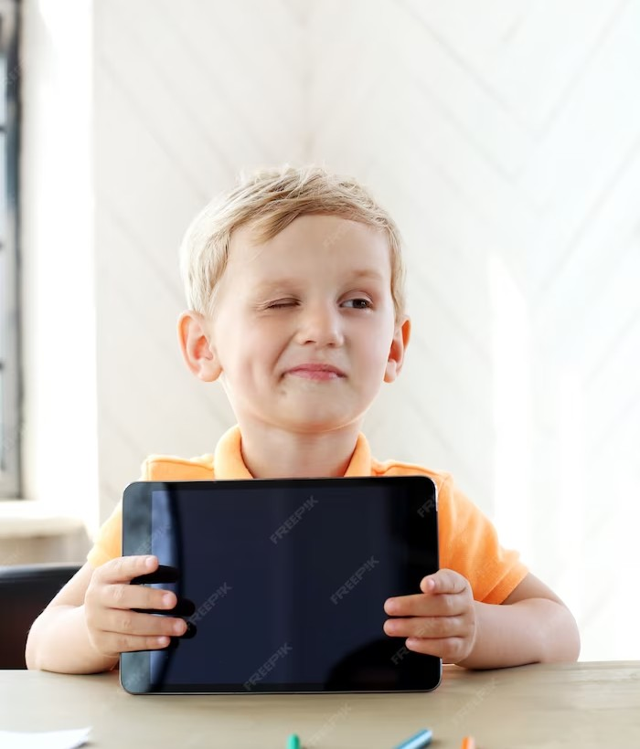
INNOVATIVE LEARNING
Innovative learning methods, such as technology and games, can make education more engaging and fun for children.
These methods can also help
children learn at their own pace and in a way that suits their individual needs.

Slide 8

The Role of Teachers
Teachers play a crucial role in ensuring that children receive a quality education. They inspire, motivate, and guide children on their learning journey. Teachers also play a key role in creating a safe and inclusive learning environment.

Slide 9

THE POWER OF COMMUNITY
Community support is essential for ensuring that children have access to education. When communities come together to support education, they can provide resources, funding, and advocacy for children's right to learn.

Slide 10
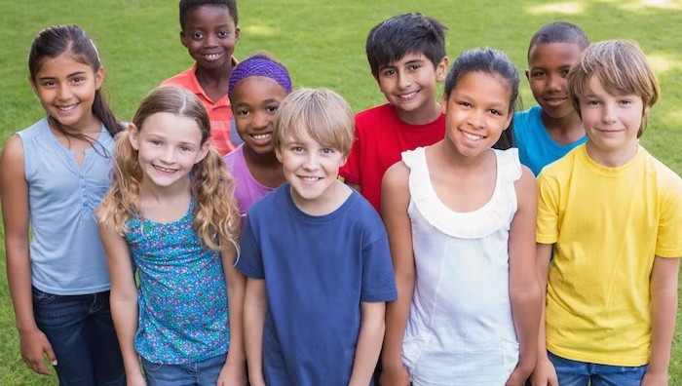
Let's Make a Difference
Together, we can make a difference in the lives of children around the world. By supporting education and advocating for children's right to learn, we can help create a brighter future for all. Let's work together to ensure that learning is fun- damental for every child!

Slide 11
THANK YOU!
Thank you for joining us today to learn about the importance of education for children. We hope you feel inspired to take action and make a difference in the lives of children around the world. Remember, learning is fun-damental!

Slide 12

Thanks!
Do you have any questions? youremail@freepik.com
+91 620 421 838
yourcompany.com

